Slide 1
CHAPTER – 01 COMPUTER FUNDAMENTALS
XI
Computer Science (083)
Board : CBSE
Unit 1
Computer Systems and Organisation (CSO)

Slide 2
Unit I
Computer Systems and Organisation (CSO)
(10 Theory + 02 Practical)
Prepared by
Manish Kumar
M Phil (Computer Sc)
Department of Computer Science, Sainik School Gopalganj)
Cell :9931640949
Email : manish_mca2004@rediffmail.com
Courtesy CBSE

Slide 3
What you are going to study in this Unit I?
Basic Computer Organisation: Introduction to computer system, hardware, software, input device, output device, CPU, memory (primary, cache and secondary), units of memory (Bit, Byte, KB, MB, GB, TB, PB)
● Types of software: system software (operating systems, system utilities, device drivers), programming tools and language translators (assembler, compiler & interpreter), application software
● Operating system (OS): functions of operating system, OS user interface

Slide 4
What you are going to study in this Unit II?
Boolean logic: NOT, AND, OR, NAND, NOR, XOR, truth table, De Morgan’s laws and logic circuits
● Number system: Binary, Octal, Decimal and Hexadecimal number system; conversion between number systems.
● Encoding schemes: ASCII, ISCII and UNICODE (UTF8, UTF32)
● Emerging trends: Cloud computing, cloud services (SaaS, IaaS, PaaS), blockchains, Artificial Intelligence (AI), Machine Learning (ML), Internet of Things (IoT)

Slide 5
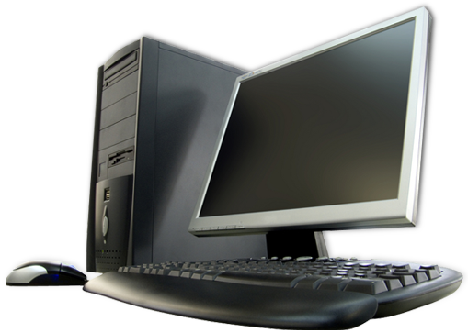
What is Computer?
A computer is a device that can be instructed to carry out sequences of arithmetic or logical operations automatically. Modern computers have the ability to follow generalized sets of operations, called programs. These programs enable computers to perform an extremely wide range of tasks.
Source Wikipedia

Slide 6
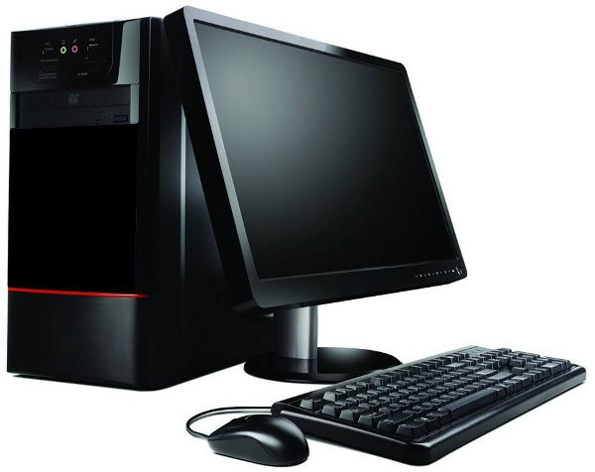
What is Data?
Data. Data in a computer terminology mean raw facts and figures.
For ex-mohan,1977 etc.
What is Information?
means what we get after processing.

Slide 7
Data Vs. Information?
you should understand that what goes in the computers is data and what comes out of them is information.
This process of turning data into information is also known as information processing cycle.

Slide 8
BASIC COMPUTER ORGANISATION

Slide 9
BASIC COMPUTER ORGANISATION
Computer organisation refers to logical structure of a computer how its components are connected to one another
ALU
Registers
Control
Memory
Memory
Memory
Memory

Slide 10
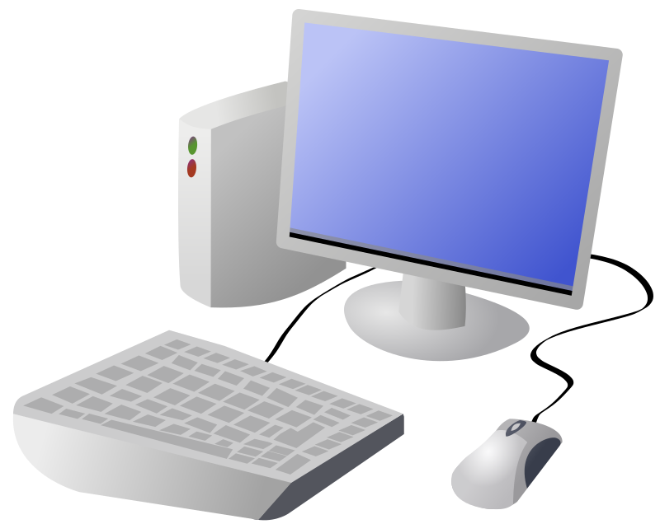
Functional components of a Computer
Input Unit
CPU
Output Unit
Memory

Slide 11
Input Unit
The input unit consists of input devices that are attached to the computer.
These devices take input and convert it into binary language that the computer understands.
Some of the common input devices are keyboard, mouse, joystick, scanner etc.

Slide 12
Input Unit

Slide 13
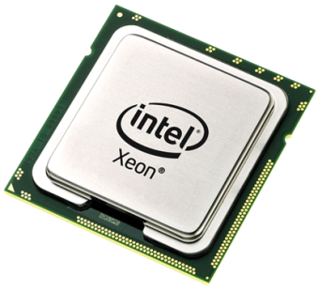
Central Processing Unit(CPU)
Once the information is entered into the computer by the input device, the processor processes it.
The CPU is called the brain of the computer because it is the control centre of the computer.
As the CPU is located on a small chip, it is also called the Microprocessor.

Slide 14
Central Processing Unit(CPU)
The CPU has three main components which are responsible for different functions –
Arithmetic Logic Unit (ALU),
Control Unit (CU) &
Memory registers.

Slide 15
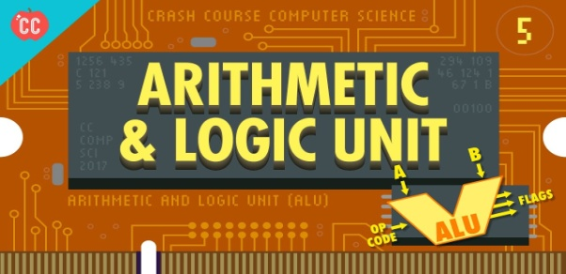
Arithmetic Logic Unit (ALU)
The ALU, as its name suggests performs mathematical calculations and takes logical decisions. Arithmetic calculations include addition, subtraction, multiplication and division.
Logical decisions involve comparison of two data items to see which one is larger or smaller or equal.

Slide 16
Control Unit (CU)
CU
The Control unit coordinates and controls the data flow in and out of CPU and also controls all the operations of ALU, memory registers and also input/output units.
It is also responsible for carrying out all the instructions stored in the program.

Slide 17
Memory Registers
MR
A register is a temporary unit of memory in the CPU.
These receive data/information and then this data/information is held in them as per the requirement.

Slide 18
Output Unit
The output unit consists of output devices that are attached with the computer.
It converts the binary data coming from CPU to human understandable from. The
common output devices are monitor, printer, plotter etc.

Slide 19
Hardware and Software

Slide 20
Hardware and Software
A program is a sequence of instructions that perform a particular task. A set of programs form a software.
It is the software which gives hardware its capability.
Hardware is of no use without software and software cannot be used without hardware.

Slide 21
Types of Software
Software can be broadly are categorized as:
System Software
Application Software
Utility Software

Slide 22
Types of Software

Slide 23
System Software
System Software is the software that is directly related to coordinating computer operations and performs tasks associated with controlling and utilizing computer hardware. These programs assist in running application programs and are designed to control the operation of a computer system.

Slide 24
System Software
System software directs the computer what to do, when to do and how to do. System software can be further categorized into:-
Operating System
Language Translators

Slide 25
Operating System
An Operating system is the most important system software.
It is a set of programs that control and supervise the hardware of a computer and also provide services to application software, programmers and users. Ex :- DOS, Windows, Unix, Linux, Solaris, etc.

Slide 26
Functions of Operating System
Process Management
Memory Management
File Management
I/O Device Management

Slide 27
LANGUAGE TRANSLATOR →Compiler →Interpreter →Assembler

Slide 28
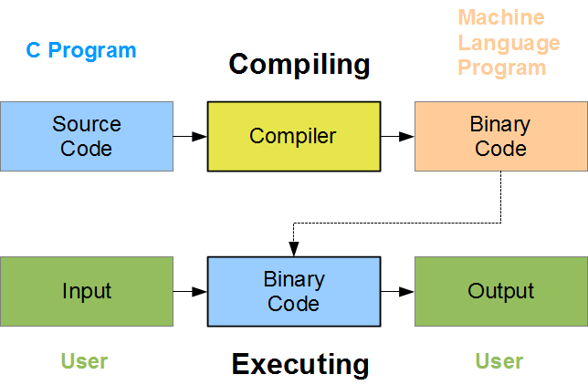
COMPILER
Its a translator used to convert HLL to MLL and vice versa.

Slide 29
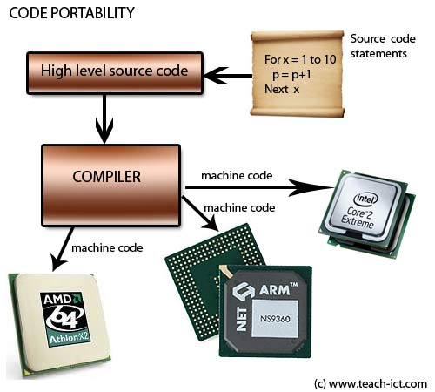
COMPILER
Its a translator used to convert HLL to MLL and vice versa.

Slide 30
INTERPRETER
Its a translator used to convert HLL to MLL and vice versa.

Slide 31
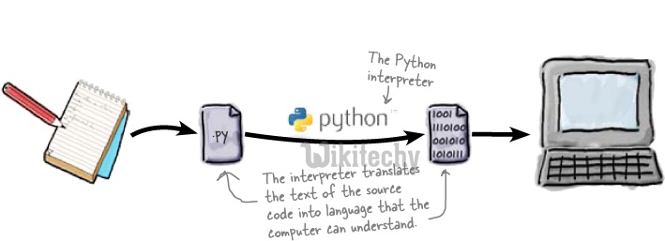
INTERPRETER
Its a translator used to convert HLL to MLL and vice versa.

Slide 32
ASSEMBLER
It translates an assembly language program into machine language.

Slide 33
APPLICATION SOFTWARE

Slide 34
Application Software
An application software is bought by the user to perform specific applications or tasks.
Say for example making a document or making a presentation or handling inventory or managing the employee database.

Slide 35
Application Software
An application software can be of two types:
General Purpose Application Software &
Customized Application software.

Slide 36
Application Software - General Purpose Application Software
Some of the application software is made for the common users for day to day applications and uses.
These are also referred as Office Tools.
The users may use them in the manner they want.

Slide 37
Application Software - General Purpose Application Software
Some of the popular types of general purpose application software are:
Word Processor
Presentation Tools
Spreadsheet Packages
Database Management System

Slide 38
Application Software - Customized Software
Customized Software is one which is tailor made as per the user’s requirement. Such type of software is customer specific.
It is made keeping in mind the individual needs of the user and so are also referred as Domain Specific Tools

Slide 39
Application Software - Customized Software
Examples:
Inventory Management System & Purchasing System
School Management System
Payroll System
Financial Accounting
Hotel Management
Reservation System
Weather Forecasting system

Slide 40
Utility Software
Utilities are small programs that maintain the health of the computer system.
Disk Cleanup - Disk cleanup tools assist users in freeing up disk space.
Disk Defragmenter - Disk defragmenter is a disk management utility that increases file access speeds by rearranging fragmented files on contiguous locations.
Backup - Backup utility enables backing up of files, folders, databases or complete disks.
File management tools - Utility software providing regular file management tasks like browse, search, update, preview, etc. are called file management tools.
Restore – This utility restores the backup earlier taken.
Antivirus – Check the system for malware.

Slide 41
MEMORY CONCEPTS

Slide 42
Memory
Memory is one of the most important components of a computer system as it stores data and instructions.
Every memory chip contains thousands of memory locations. In the computer, the data is stored in the form of bits and bytes.

Slide 43
Memory
A bit is the smallest storage unit of memory. A nibble is a collection of 4 bits. Eight bits combined together to form a single byte, which in turn represents a single character

Slide 44
Memory Units

Slide 45
Memory Units

Slide 46
Permanent
Storage areas
Temporary Storage areas
1
CPU
3
RAM
Virtual
4
Storage Devices
ROM/BIOS
Removable Devices
Physical
Network/Internet Storage
Hard Drives
2
Cache
Registers
Level 1
Level 2

Slide 47
Types of Memories
The computer memories can be divided into following categories:
Primary Memory
Cache Memory
Secondary memory

Slide 48
Primary Memory
Primary memory or main memory is a Metal Oxide Semiconductor (MOS) memory used for storing program and data during the execution of the program. It is directly accessible to CPU.

Slide 49
Primary Memory
Broadly primary memory
can be of two types :–
1. RAM (Random Access Memory)
2. ROM (Read only memory).

Slide 50
Random Access Memory (RAM)
the memory can be accessed from any desired location randomly.
The instructions and data that we input into the computer are stored in
the RAM of the Computer.
It is a read/write memory, so data can be both read from and written to the RAM.

Slide 51
Random Access Memory (RAM)
It is a volatile memory and loses its contents when the power is switched off or interrupted.
Nowadays RAMs are available in gigabytes. The normal memory access time of a RAM is 20-80 ns.

Slide 52
Random Access Memory (RAM)
RAM can be broadly classified into two categories:
Dynamic RAM (DRAM) and
Static RAM (SRAM).

Slide 53
Dynamic RAM (DRAM)
It consists of a transistor and a capacitor that stores electric charge.
The DRAMs are physically smaller, cheaper and slower memories. They are slower because the data stored in them needs to continuously refreshed and this consumes lot of processor time.

Slide 54
Dynamic RAM (DRAM)
Each refresh operation takes several CPU cycles to complete. This is because a capacitor tends to loose charge over a period of time which needs to be refreshed again and again.

Slide 55
Static RAM
This type of RAM is large in physical size but is an expensive and faster memory.
It is faster because it is made up of flip flops to store data and these flip flops do not require any refreshing.

Slide 56
Static RAM
Static RAM is also volatile and is easier to use as compared to dynamic RAM. These are used in specialized applications.

Slide 57
DRAM Vs. Static RAM

Slide 58
ROM
Its non volatile memory, ie, the information stored in it, is not lost even if the power supply goes off. It’s used for the permanent storage of information. It also posses random access property. Information can not be written into a ROM by the users/programmers. In other words the contents of ROMs are decided by the manufactures.

Slide 59
Types of ROM
(i) PROM : It’s programmable ROM. Its contents are decided by the user. The user can store permanent programs, data etc in a PROM. The data is fed into it using a PROM programs.

Slide 60
Types of ROM
(ii) EPROM : An EPROM is an erasable PROM. The stored data in EPROM’s can be erased by exposing it to UV light for about 20 min. It’s not easy to erase it because the EPROM IC has to be removed from the computer and exposed to UV light. The entire data is erased and not selected portions by the user. EPROM’s are cheap and reliable.

Slide 61
Types of ROM
(iii) EEPROM (Electrically Erasable PROM) : The chip can be erased & reprogrammed on the board easily byte by byte. It can be erased with in a few milliseconds. There is a limit on the number of times the EEPROM’s can be reprogrammed, i.e.; usually around 10,000 times.

Slide 62
Flash Memory
Its an electrically erasable & programmable permanent type memory. It uses one transistor memory all resulting in high packing density, low power consumption, lower cost & higher reliability. Its used in all power, digital cameras, MP3 players etc.

Slide 63
Cache Memory
Cache memory is a special high speed memory made up of high speed static RAMs.
It is used to hold frequently accessed data and instructions.
We know that the processing speed of CPU is much more than the main memory access time of the computer.

Slide 64
Cache Memory
This means the CPU has to wait for a substantial amount of time.
Alternatively we have the cache memory which is a small, expensive but fast memory that is placed between the CPU and the main memory.

Slide 65
Cache Memory
Whenever some data is required, the CPU first looks into cache.
If data is found, we call it a cache hit and the information is transferred to the CPU.
In case of a miss, the main memory is accessed.

Slide 66
Cache Memory
There are two types of cache memory:
L1 cache: It is small and is built inside the CPU. It is fast as compared to L2 cache
L2 cache: It is large but slower and is mounted on the motherboard

Slide 67
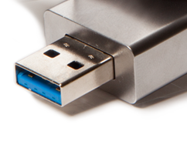
Secondary Memory

Slide 68
Secondary Memory
The major limitation of primary memory is that it has limited storage capacity and is volatile.
To overcome this limitation we have secondary memory storage devices. This type of memory is also called external memory. For example Floppy disk, hard disk, USB drives, CD/DVDs

Slide 70
OPTICAL DISKS

Slide 71
OPTICAL DISKS
An optical disk is primarily used as a portable and secondary storage device. It can store more data than the previous generation of magnetic storage media, and has a relatively longer lifespan. Compact disks (CD), digital versatile/video disks (DVD) and Blu-ray disks are currently the most commonly used forms of optical disks. These disks are generally used to:
Distribute software to customers.
Store large amounts of data such as music, images and videos.
Transfer data to different computers or devices.
Back up data from a local machine.

Slide 72
Thank You

